Slide 1
WSN@work Gateway prototyping Peter Van Aken/Alain Maes

Slide 2
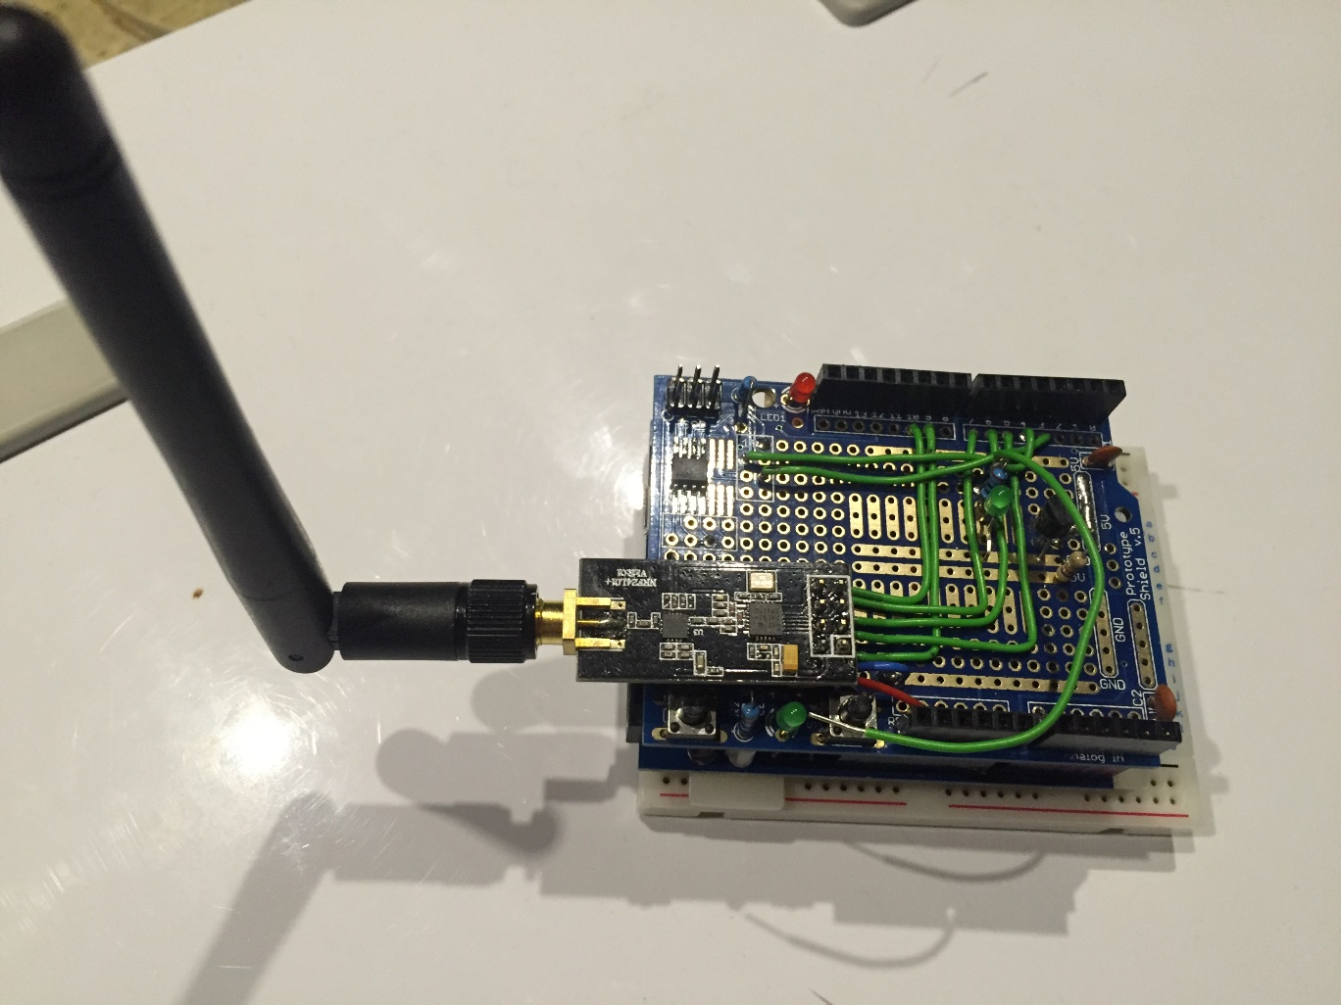
Wemos & protoshield

Slide 3
Wemos & protoshield
Pro :
LDO can power for NRF with PA
Integrated serial-(micro)USB
Easy access to GPIO
Arduino (proto)shield compatible
SOIC footprint for ATSHA204
Con :
A bit of soldering when using shield
No run/flash switch (stability test)

Slide 4
Wemos & protoshield
Alie:
Wemos :
http://nl.aliexpress.com/item/WeMos-D1-WiFi-uno-based-ESP8266-for-arduino-Compatible/32458787267.html
Shield : “arduino proto shield”
Ebay:
Wemos : http://www.benl.ebay.be/itm/221949739425?clk_rvr_id=977251000263&rmvSB=true
Shield :
http://www.benl.ebay.be/itm/381382884053?clk_rvr_id=977239437874&rmvSB=true

Slide 5
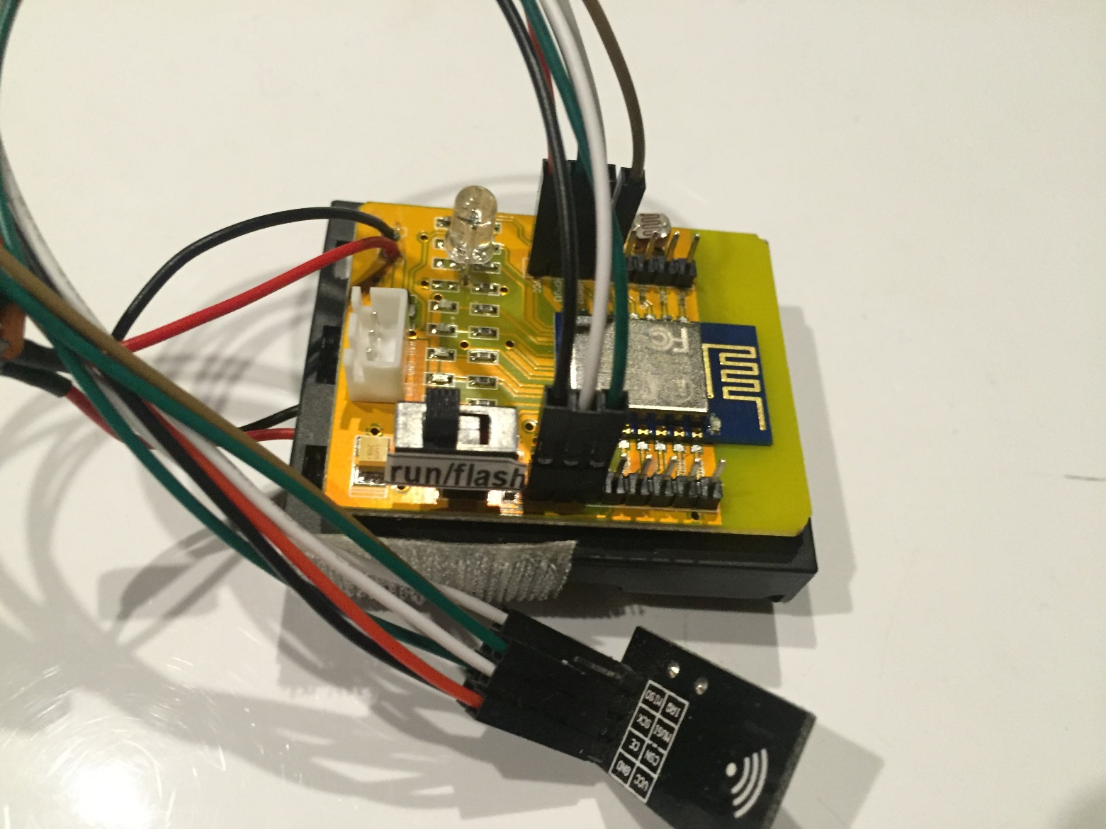
ESP8266 test board with IO leads

Slide 6
ESP8266 test board with IO leads
Pro :
Easy powering via battery / mobile
Run/Flash switch
LDR/RGB led (learn ESP, not GW specific)
No soldering
Con :
No standard shield form factor
NRF with PA not possible (LDO limited power)
External USB-serial required
SOIC breakout for ATSHA204

Slide 7
ESP8266 test board with IO leads
Alie :
Board: http://nl.aliexpress.com/item/ESP8266-ESP-12E-serial-WIFI-Industrial-stable-version-A-full-test-board-Full-IO-leads/32370570377.html
USB-serial :

Slide 8
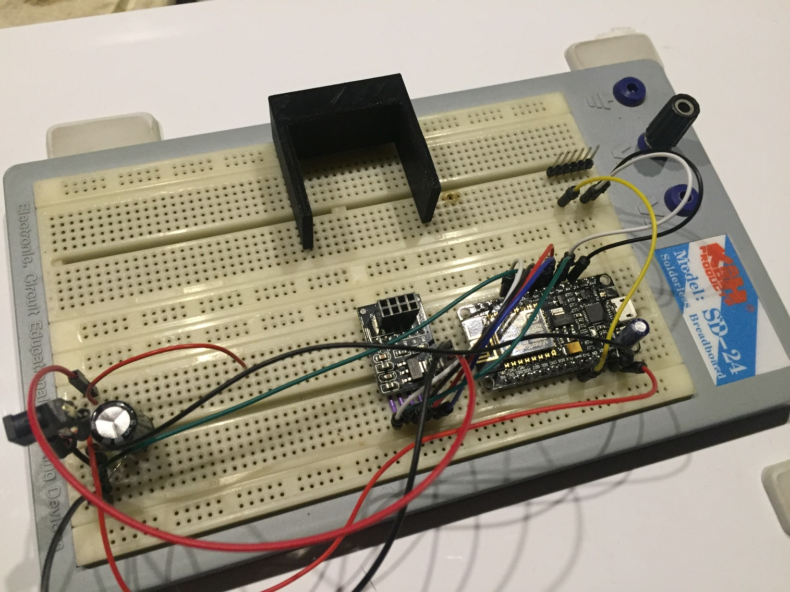
NodeMCU

Slide 9
NodeMCU
Pro :
Easy to connect to GPIOs via breadboard. No soldering.
USB-serial integrated
Con :
No Run/Flash switch
Powering NodeMCU with NRF PA attached gave problems for me (*)
SOIC breakout for ATSHA204

Slide 10
NodeMCU
Alie :
http://nl.aliexpress.com/item/V2-4M-4FLASH-NodeMcu-Lua-WIFI-Networking-development-board-Based-ESP8266/32448662166.html

Slide 11
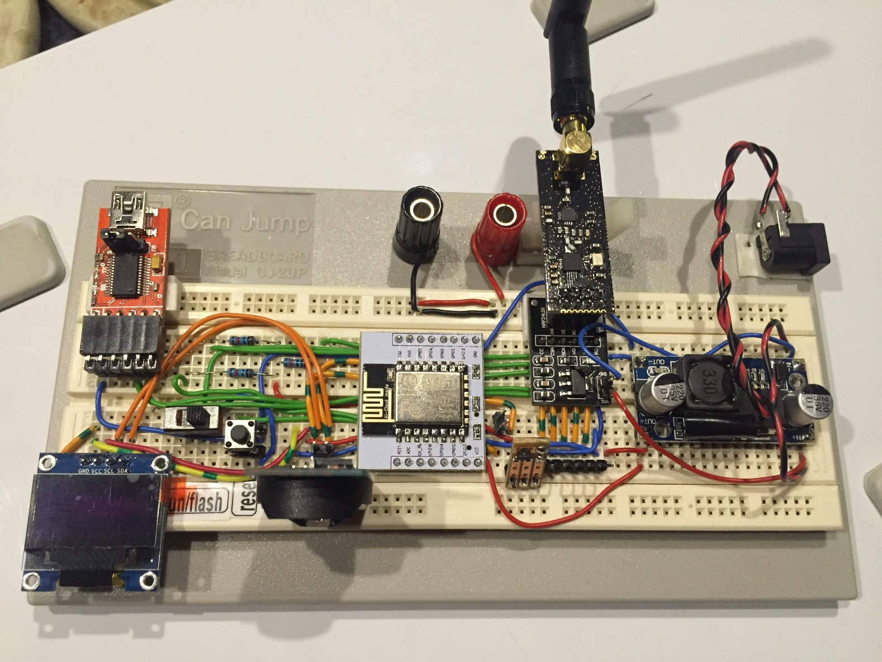
Full breadboard

Slide 12
Full breadboard
Pro :
Easy to connect to GPIOs via breadboard, very flexible.
“unlimited” power from supply
Run/Flash switch
Con :
Limited soldering
SOIC breakout for ATSHA204
External USB-serial

Slide 13
Full breadboard
Alie:
ESP12:
Breakout:
USB-serial:
Power supply:
RTC
OLED
ATSHA204

Slide 14
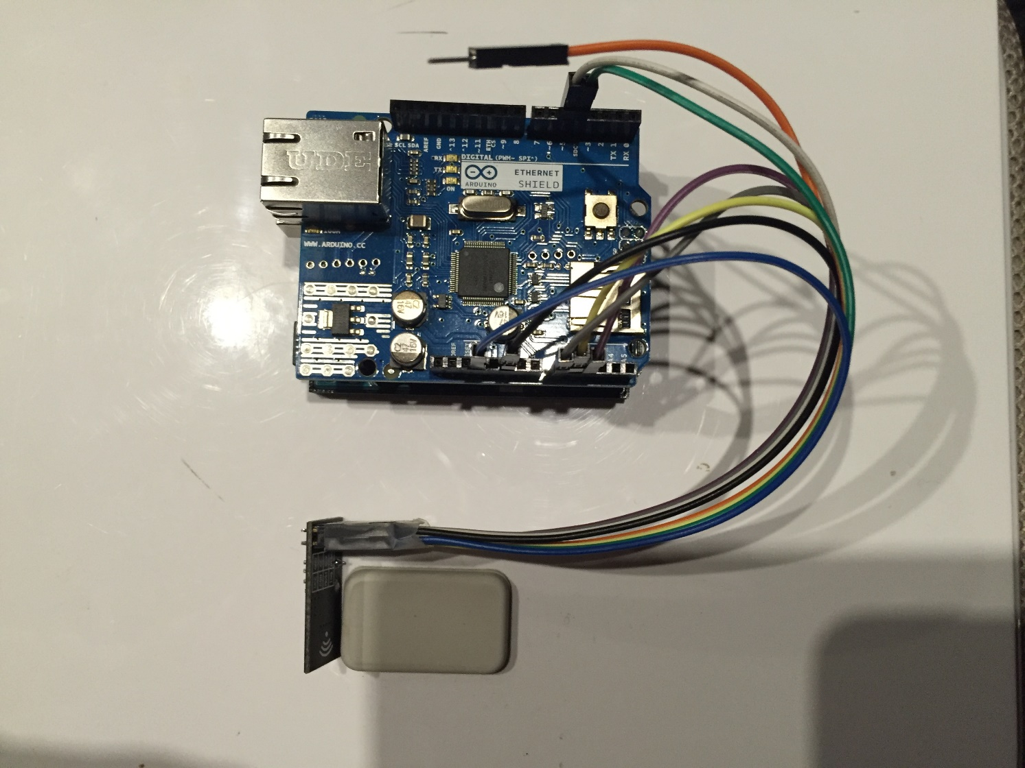
Arduino UNO / Ethernet shield

Slide 15
Arduino UNO / Ethernet shield
Pro :
Easy to connect (see also Wemos protoshield)
Plug & play
Con :
Ethernet connection required
Limited configuration & extention options
Hardcoded settings
Memory footprint > 90 % (on nano 96% !!)
Power consumption ethernet shield

Slide 16
Arduino UNO / Ethernet shield
Alie:
Ethernet : http://nl.aliexpress.com/item/W5100-Ethernet-Shield-for-Arduino-Main-Board-UNO-R3-ATMega-328-1280-MEGA2560-1Pc/32417441214.html?spm=2114.010208.3.28.npM0nn&ws_ab_test=searchweb201556_9,searchweb201644_4_505_506_503_504_301_502_10014_10001_10002_10016_10017_10010_10005_10011_10006_10003_10004_401_10009_10008,searchweb201560_3,searchweb1451318400_-1,searchweb1451318411_6448&btsid=c4c77b18-21f4-426b-aefa-c9472589e6d0
Remark : Ethernet shield 2. (wiznet W5500)

